Slide 1

Perengo Data Science Challenge
2/12/2020
Presenter: Daniel Fan

Slide 2
Data analysis/Familiarization
## Base Assumptions ##
- Dates: Hold no predictive power in terms of conversions
- The data is assumed to be representative of the conversion environment behaviors. This is to say that the insights extracted from this subset of the data will generalize to the larger dataset.
- Instances where the conversions are higher than clicks are treated as data error and filtered. In the real world this may not be the case, as the applications may have been driven from exterior forces outside the campaign.

Slide 3
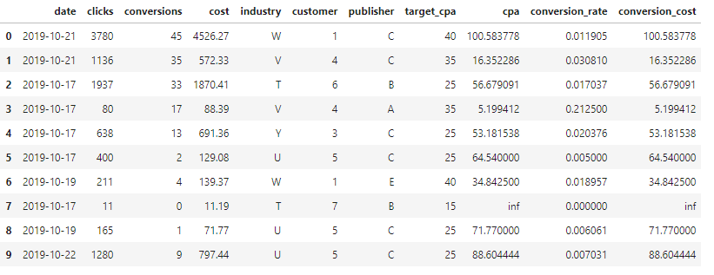
Data analysis/Familiarization
Categorical for customer, publisher and industry
Some inf due to no conversion on campaign

Slide 4
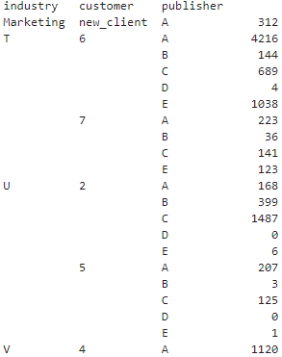
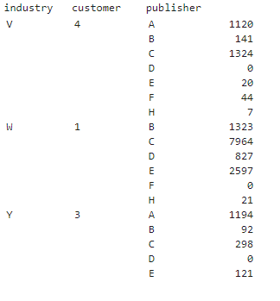
Data analysis/Familiarization: Total conversions

Slide 5
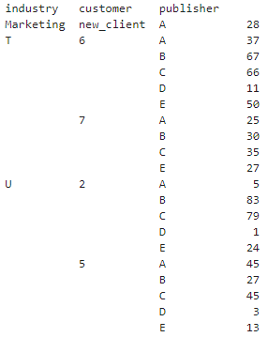
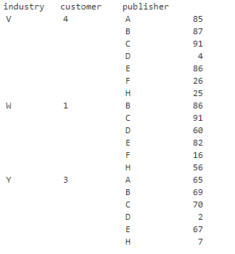
Data analysis/Familiarization: Total # of campaigns

Slide 6
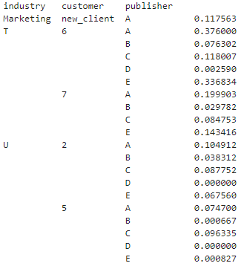
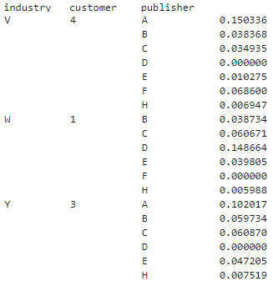
Data analysis/Familiarization: conversion rate

Slide 7
Main Features
Industry: ~15%
Customer ~35%
Publisher ~50%
Obtained from decision tree feature importance

Slide 8
Modelling Approaches: Decision Tree
Used to model which configuration achieves an acceptable cpa
Target variable set to be less that 10% more than the target cpa
Accuracy of ~ 70 percent

Slide 9
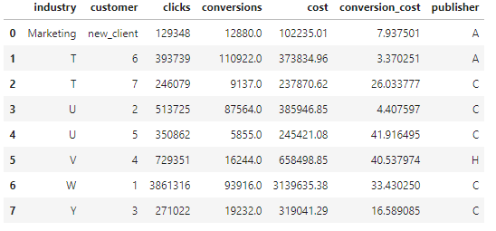
Modelling Approaches: Monte Carlo SimulatioN
Used current dataset to bootstrap simulation
1000 campaigns at each setting
Note conversion_cost is not optimized

Slide 10
Maximising conversions
If we look at the distribution of the campaigns in the data we have the highest average conversion rates at using the following settings:
- Industry T at publisher A
- Industry U at publisher C for customer 2
- Industry U at publisher A for customer 5
- Industry V at publisher A
- Industry W at publisher C
- Industry Y at publisher A
and we have the most campaigns run at the following publishers:
- Industry T at publisher B
- Industry U at publisher C
- Industry V at publisher C
- Industry W at publisher C
- Industry Y at publisher A
To maximize conversions we could start running new campaigns at the corresponding publishers with higher conversion rates.

Slide 11
New Customer: What do we do?
Find similar older customer with assumed same behavior
Use clicks and conversions from publisher A as proxy

Slide 12
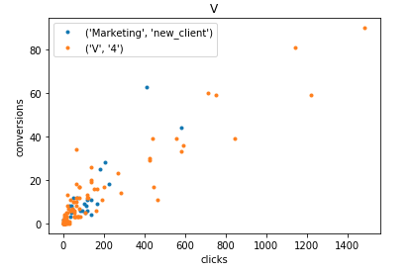
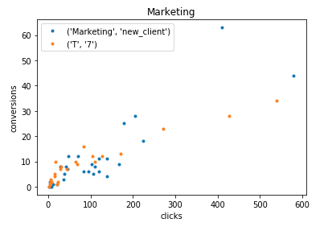
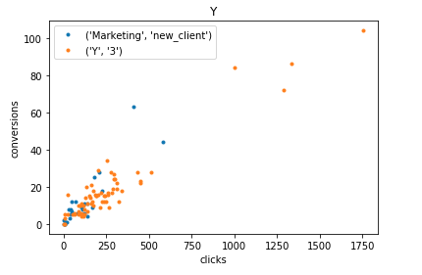
New Customer: What do we do?
The campaigns should be run at publisher A

Slide 13
Testing the recommendations
Set up new campaigns for each of the configurations (customer vs publisher)
50 campaigns at each publisher
The campaigns should be started at the same time to mitigate seasonal differences
The same variables are to be collected.
The results can be measured with a direct comparison of the conversion and the cost of campaigns
Test that the difference in performance (conversion rate) is statistically significant between publishers
The experiment should be run for 2-4 weeks.
Pros: direct observable comparisons.
Cons: costly when considering more variables.

